Slide 1
Writing Skills – Introduction

Slide 2
Lecture topics
Course motivation
Course structure
Assignments
Experimental setting

Slide 3
Course motivation

Slide 4
Course motivation
Writing is useful
Convey technical ideas and concepts
Store and share information

Slide 5
Course motivation
Reading is useful as well
Other people's documents
Papers and other people's research

Slide 6
Learning Research Writing
It's not just about writing or reading
Research writing is a methodology for
Reading others' papers
Identifying truth with certainty (is algorithm X better than algorithm Y?)
Proving something
Writing technical matters

Slide 7
Reading other papers
Scientific research is about reaching new places
New rendering algorithms
New AI techniques
New computer vision techniques
New programming languages
…

Slide 8
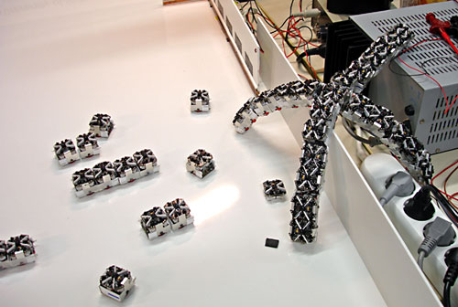

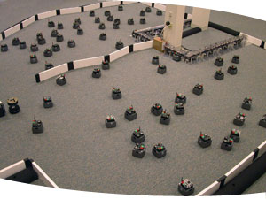
Swarm intelligence

Slide 9
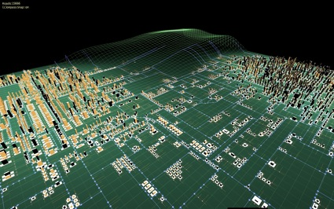


Procedural generation

Slide 10
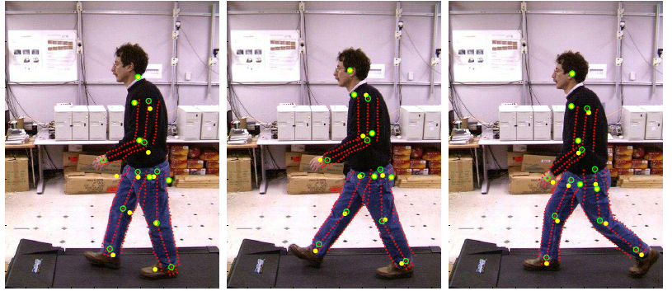

Motion tracking

Slide 11
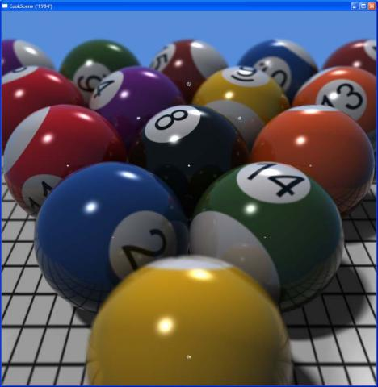
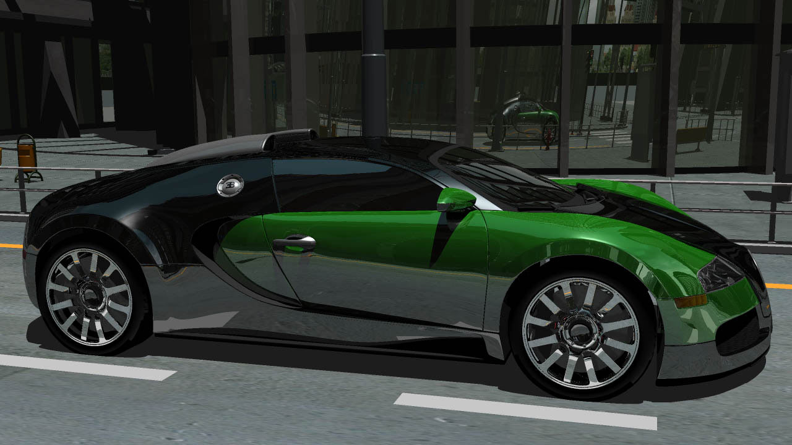
Ray tracing

Slide 12
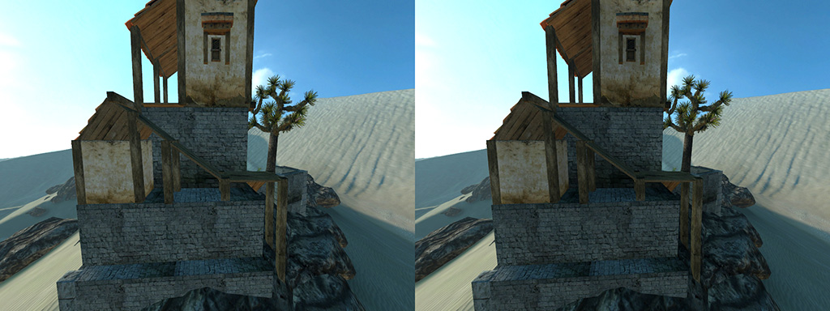
Pipeline rendering

Slide 13
And much, much more
AI
Automated game-play balancing
Procedural story-telling
Domain specific programming languages
...

Slide 14
Discerning truth and falsity
How do you pick an algorithm, a technique, a design pattern, etc.?
Multiple options, all seem valid
No time to research all of it yourselves
Leverage other people's results

Slide 15
Proving something
Scientific results are not words
That is for politics :)
Scientific texts feature numbers, data, and/or formal proofs

Slide 16
Writing technical matters
Sum up months of complex research
In about ten pages
Clarity
Conciseness
Strong arguments
Reinforcement
Tell your audience what you're going to tell them.
Tell them.
Then tell them what you told them

Slide 17
How can we learn all this?
Let's try to avoid obvious approaches
Really, truly, deadly, boring
It's not about writing
Writing is pointless without content
Writing is pointless without reading

Slide 18
Actual research
Try some research of your own
Lite version
Build a
GPGPU application
Game in a special programming language
Entity framework
Sum up the results

Slide 19
Course structure

Slide 20
Week 1
Course overview
Assignments
Experimental settings

Slide 21
Week 2
A bit of epistemology
Gathering and presenting data
Working class session
Setup the assignment

Slide 22
Week 3
Setting up a paper
Paper templates

Slide 23
Week 4
Writing tools: Latex
Separation of content and template
High quality support for mathematical formulas
High quality support for graphs
High quality support for algorithm typesetting

Slide 24
Week 5
Lab session
Analyzing data
Writing the short paper

Slide 25
Week 6
Specialization options
How does specialization work?
Discussion on specialization ideas
Discussion on frequent research writing mistakes
Form
Data
Assertions
Problem statement
…

Slide 26
Assignments

Slide 27
Literature review
Most of your grade (80%)
Teams of up to 4
Find some interesting papers or sources on the chosen topic
Implement, test, gather data
Write a short paper, motivating conclusions with data
Start writing earlier than week 4
Write the introduction and algorithm description as early as possible
Deadline is week 5

Slide 28
Literature review topics
Topics can be:
GPGPU assignment from Jeremiah’s course
Or another parallel assignment
Experiment with entity framework structure
Build a tiny game in Casanova
You can make a proposal, but it needs to
Be small enough to complete it with little effort
Yield useful data and a testable hypothesis

Slide 29
Specialization proposal
Find and discuss options and ideas
Start now!
Find a topic/research question
Find materials that you would like to specialize on
During the whole course
Write a proposal (end of week 8)

Slide 30
That's it. Thank you!

